Slide 1


MINTO AND FOSTER FISH COLLECTION FACILITY OPERATIONS: 2014
Cameron Sharpe, Greg Grenbemer & Brett Boyd, David Griffith
Willamette Science Review
February, 2015

Slide 2
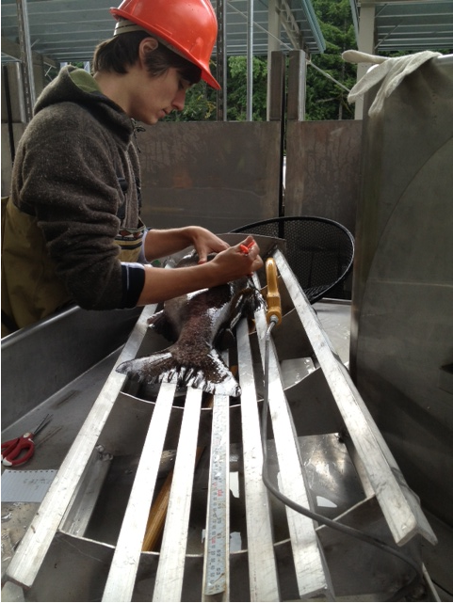
Species
Sex
Size
Fin Clips
Floy Tags
CWTs
PIT-tags
Radiotags
Scales
DNA
Disposition
Notes:
…a lot happens.

Slide 3
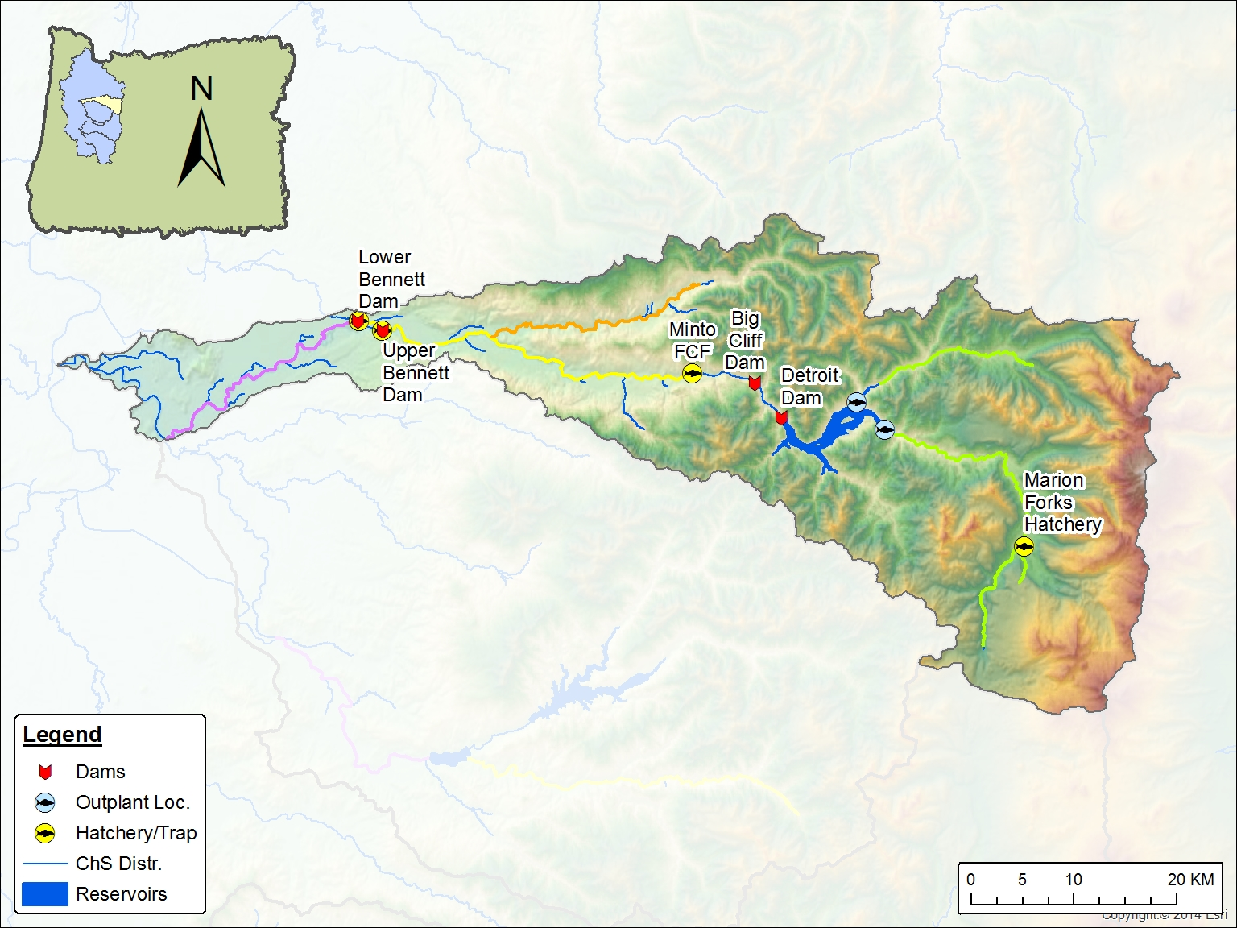

Slide 4
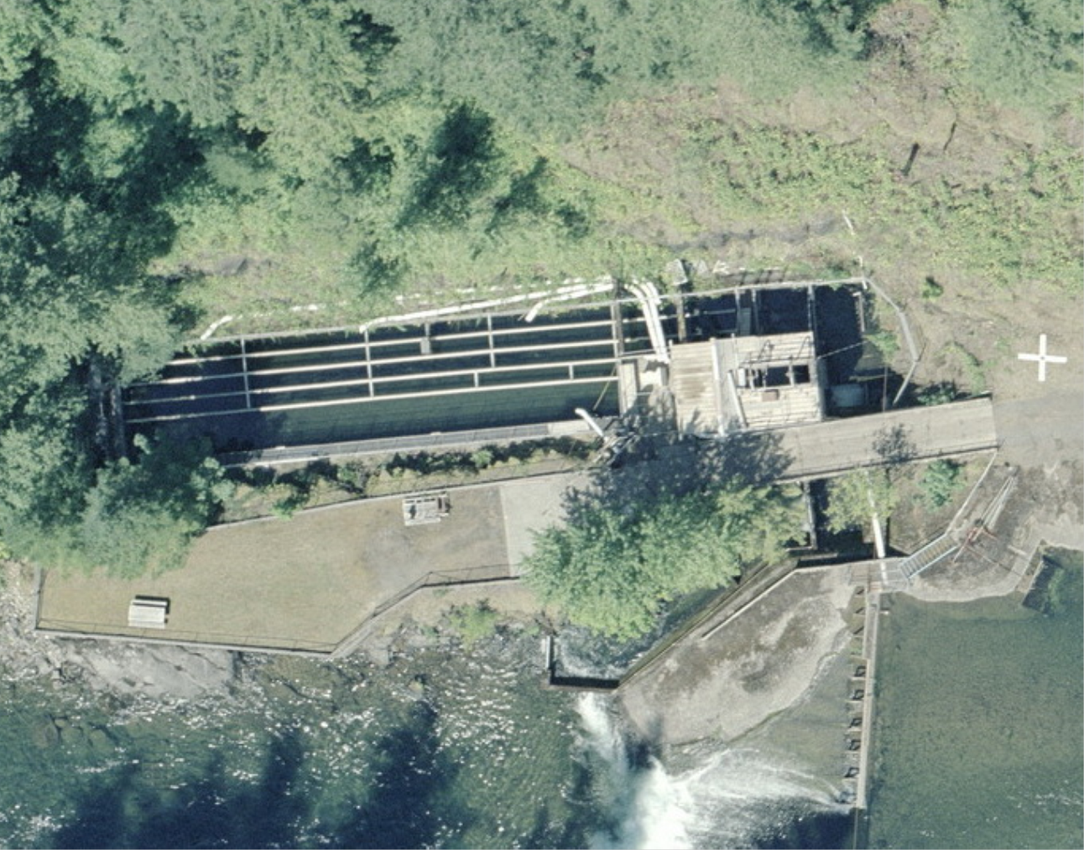
NEW MINTO
Notes:
Old Minto

Slide 5
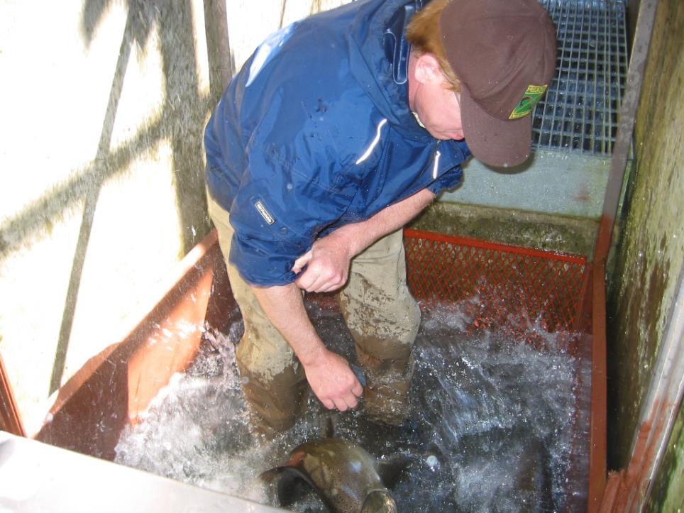
Notes:
Generally accepted shortcomings to material and methods for fish handling and sorting

Slide 6
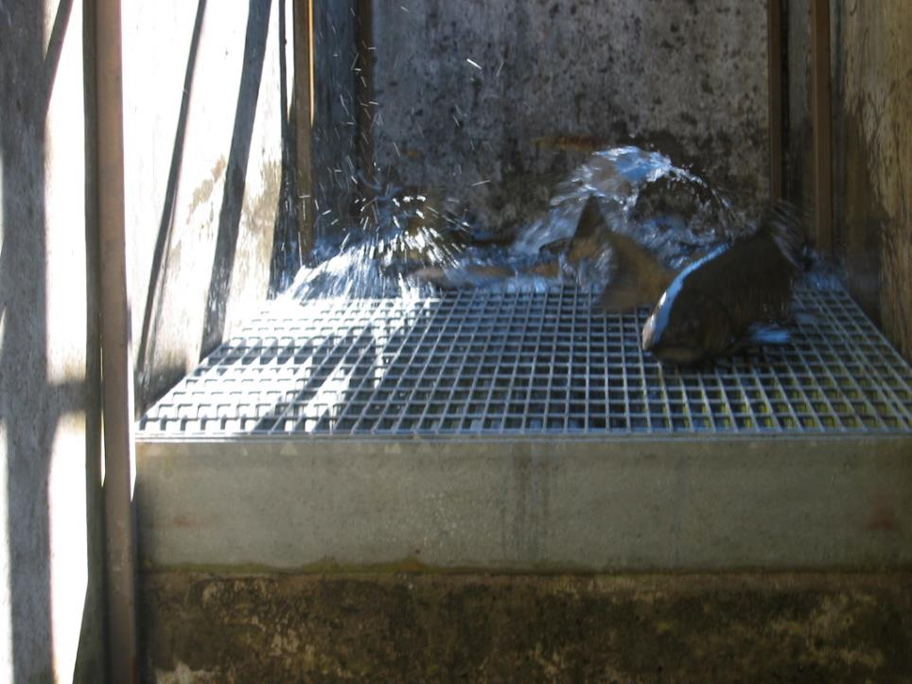
Notes:
Need to avoid dewatering and exposure to abrasive surfaces

Slide 7
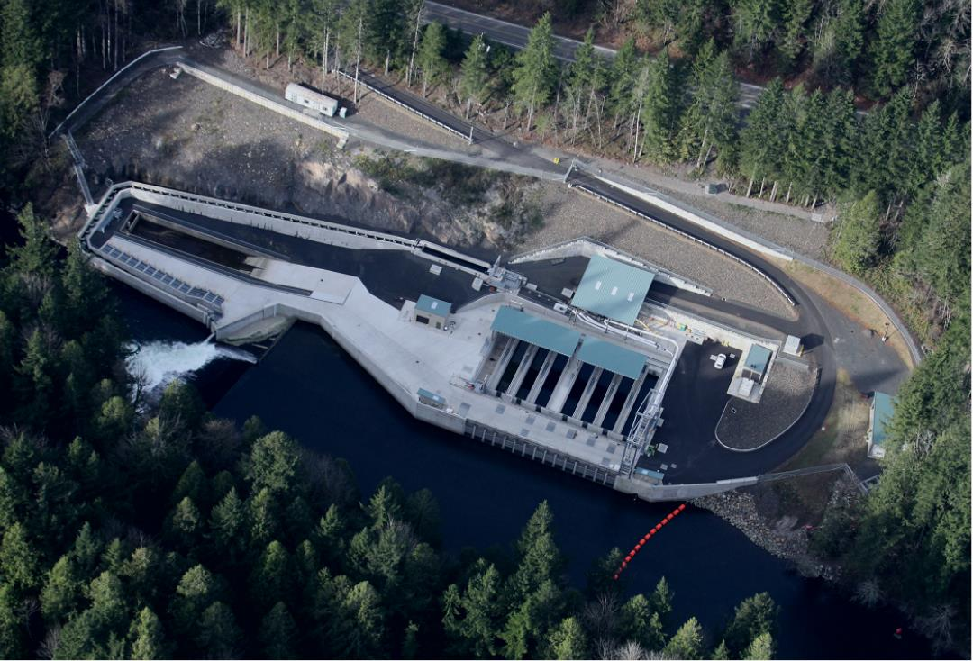
NEW MINTO
Notes:
New Minto. Shiny. Chrome don’t get you home. A much-needed new facility is in place but is it effective?

Slide 8
Notes:
Chinook

Slide 9
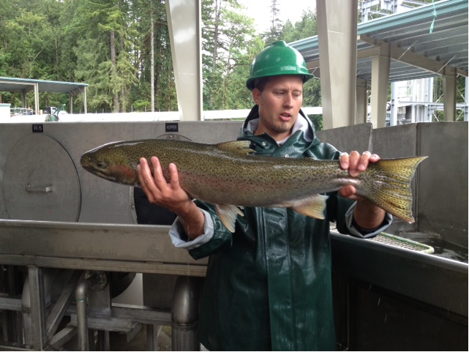
Notes:
Steelhead

Slide 10
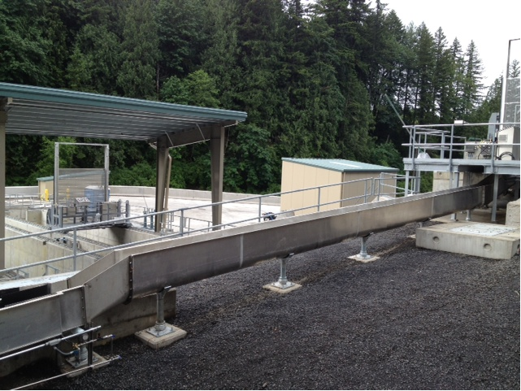
Notes:
Sorting pool leads to a watered flume which leads to either gates directing individual fish to various holding ponds or…

Slide 11
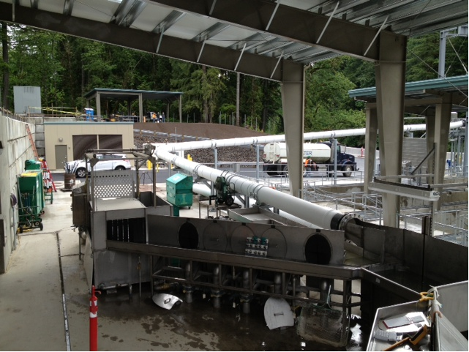
Notes:
…directly to a sampling station where…

Slide 12
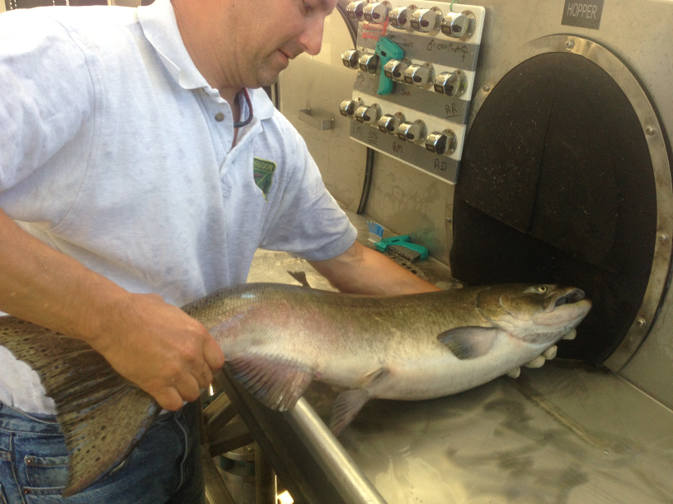
Notes:
After sampling and decisions made for disposition of individual fish…

Slide 13
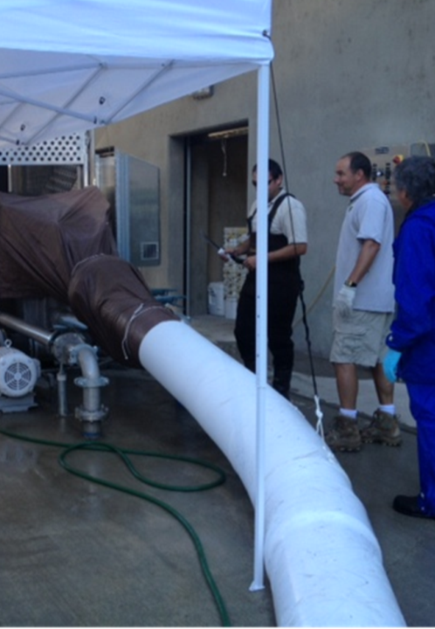
Notes:
…fish delivered to their fates through a fascinating system of pipes. Actual 2013 dispositions were…

Slide 14
FISH DISPOSITIONS AT MINTO
BROODSTOCK (2014: CLIPPED FISH ONLY)
OUTPLANTING (2014: CLIPPED FISH ONLY)
PASSAGE (2014: UNCLIPPED FISH ONLY)
Outplant site | Clipped Males | Clipped Females | Unclipped Males | Unclipped Females | Unclipped Jacks | Total
Coopers | 39 | 30 | -- | -- | -- | 69
Hoover | 151 | 81 | -- | -- | -- | 232
USGS | 8 | 5 | -- | -- | -- | 13
Kanes | 139 | 79 | -- | -- | -- | 218
Hot Springs | 182 | 75 | -- | -- | -- | 257
Horn Cr | 52 | 28 | -- | -- | -- | 80
Upriver of Minto | 0 | 0 | 428 | 339 | 8 | 775
 |  |  |  |  |  | 1644
Notes:
Many, more than half were outplanted above Detroit Dam…

Slide 15
COLLECTION TIMING
Notes:
We are able to compare collection timing in 2013 at the new Minto to timing in recent years at old Minto. Caveat; single year of trapping but appears to have occurred earlier. The implication is that fish were “kegging up” below Minto.

Slide 16
COLLECTION EFFICIENCY (1)
Notes:
We have a couple of approaches to estimating efficiency of capture. We can use a long data series when considering what percent of clipped fish passing Willamette Falls were removed at Minto. Horizontal line is the mean for 2002 – 2010.

Slide 17
COLLECTION EFFICIENCY (2)
Notes:
Alternatively we can use data specific to the North Santiam by comparing efficiency in terms of what percentage of the clipped fish estimated to have passed Bennett dams were removed. Same outcome.

Slide 18
BROODSTOCK SURVIVAL
Notes:
Tricky to compare this metric because there is quite a bt of variability year to year but 2013 was on the lower end of the range

Slide 19
PSM Above Detroit
Notes:
Aother way is to look at survival of the outplanted fish. Again, prespawning mortality estimate in 2013 was on the lower end of the range. Caveat: we think PSM estimates in 2013 were biased high.

Slide 20
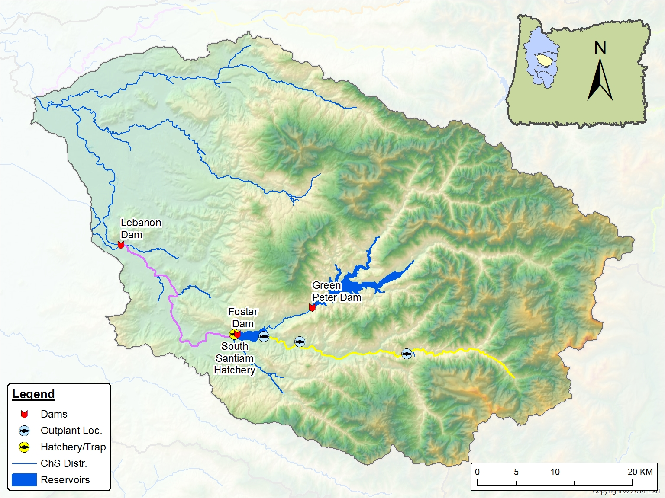

Slide 21
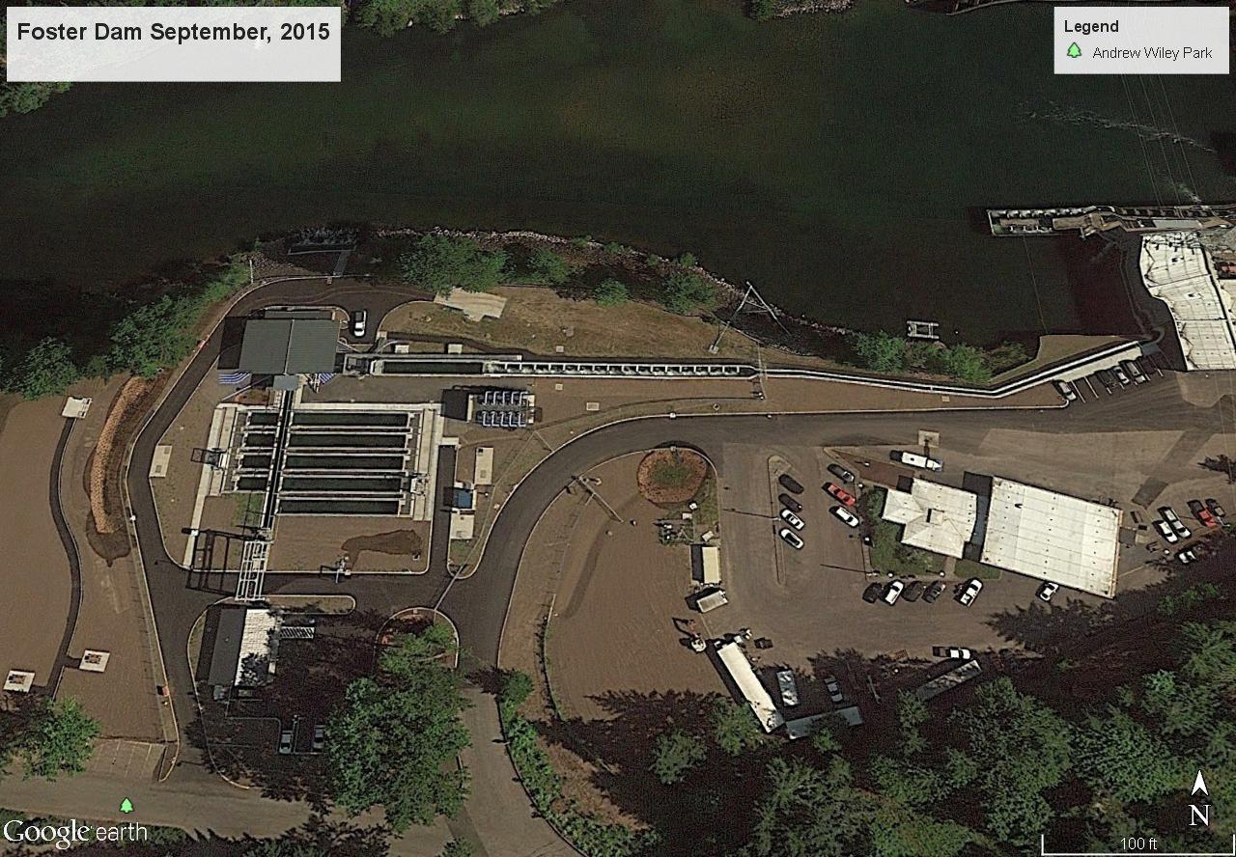
NEW FOSTER
Notes:
Questions?

Slide 22
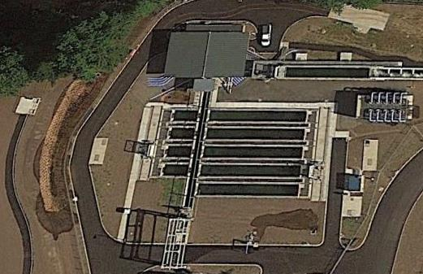
Notes:
Questions?

Slide 23
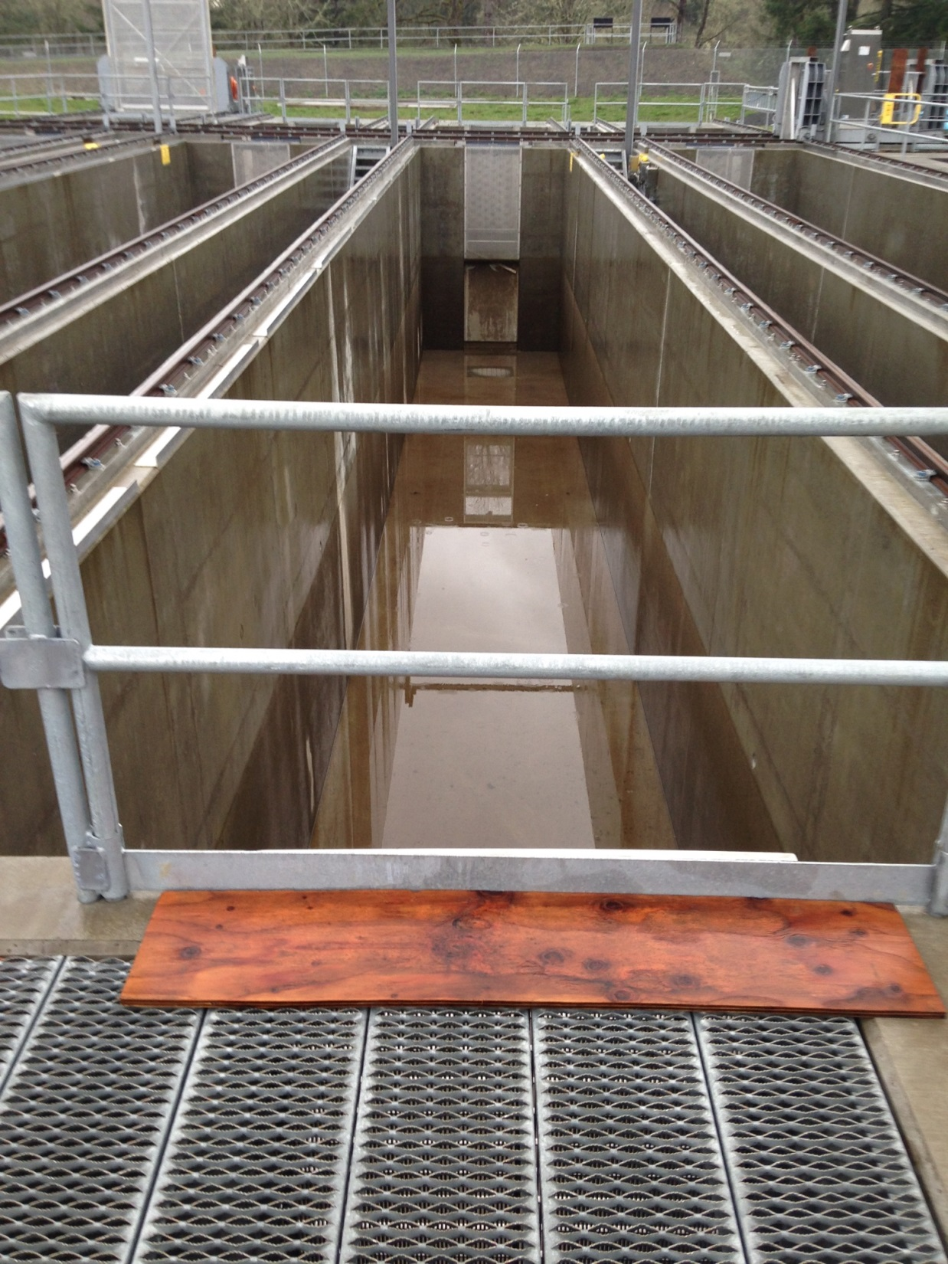
Long-term Holding Ponds
Notes:
Questions?

Slide 24
FISH DISPOSITIONS AT FOSTER
BROODSTOCK (2014: CLIPPED FISH ONLY)
OUTPLANTING (2014: UNCLIPPED FISH ONLY)
Outplant site | Unclipped Males | Unclipped Females | Unclipped Jacks | Total
Caulkens Park | 32 | 35 | 10 | 77
Gordon Road | 96 | 82 | 9 | 187
Riverbend Campground | 63 | 79 | 1 | 143
 |  |  |  | 407
Notes:
Many, more than half were outplanted above Detroit Dam…

Slide 25
Notes:
Questions?

Slide 26
Working Hypotheses
Four-Year-Old cohort failure
Ladder geometry
Attraction water from Greenpeter instead of upper S. Santiam

Slide 27
S. Santiam NOS Age Structure
Run Year | N | 3YO | 4YO | 5YO | 6YO
2002 | 191 | 0.005 | 0.691 | 0.304 | 0.000
2003 | 141 | 0.007 | 0.688 | 0.298 | 0.007
2004 | 82 | 0.012 | 0.537 | 0.451 | 0.000
2005 | 99 | 0.040 | 0.374 | 0.545 | 0.040
2006 | 44 | 0.000 | 0.682 | 0.295 | 0.023
2007 | 145 | 0.186 | 0.448 | 0.366 | 0.000
2008 | 326 | 0.242 | 0.644 | 0.113 | 0.000
2009 | 304 | 0.003 | 0.859 | 0.125 | 0.013
2010 | 94 | 0.138 | 0.574 | 0.287 | 0.000
2011 | 345 | 0.038 | 0.849 | 0.110 | 0.003
2012 | 219 | 0.064 | 0.516 | 0.397 | 0.023
Notes:
Questions?

Slide 28
Working Hypotheses
Four-Year-Old cohort failure
Ladder geometry
Attraction water from Greenpeter instead of upper S. Santiam

Slide 29
Notes:
Questions?

Slide 30
Working Hypotheses
Four-Year-Old cohort failure
Ladder geometry
Attraction water from Greenpeter instead of upper S. Santiam

Slide 32
Notes:
Questions?

Slide 33
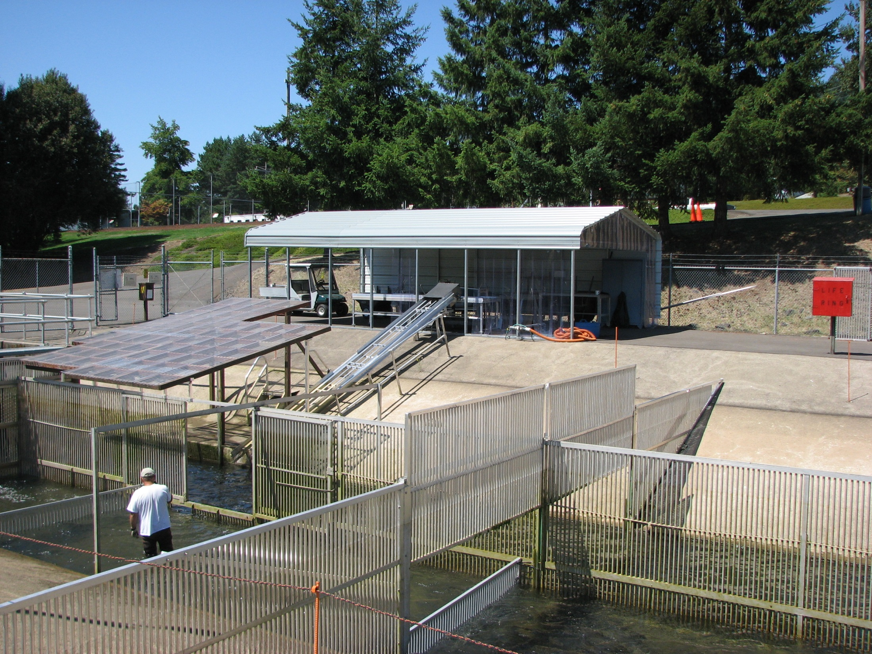
Notes:
Questions?

Slide 34
Notes:
Questions?

Slide 35
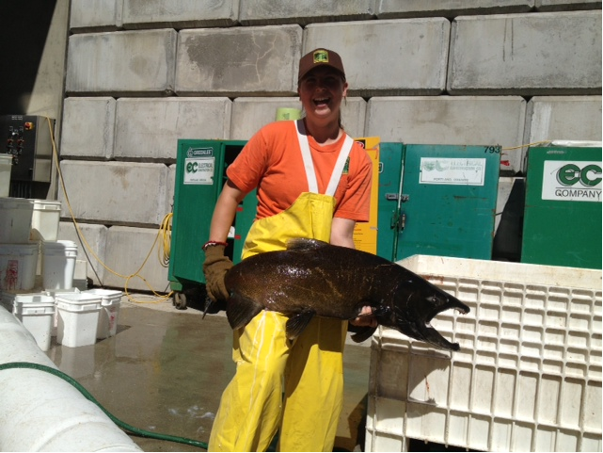
Questions?
Notes:
Questions?

